Slide 1
PRESENTED BY :- VAIBHAV KUMAR JHA
DEPARTMENT :- B.TECH CSE(AI &ML)
PRN :- 250205241005
SANDIP UNIVERSITY

Slide 2
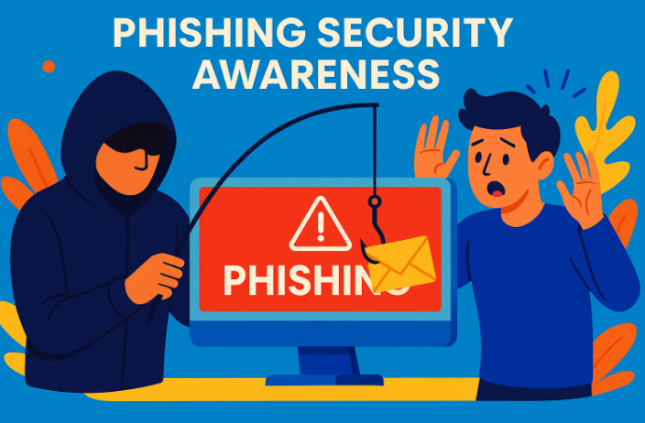
PHISHING AWARENESS TRAINING
Title :- Phishing Awareness Training
Understanding phishing attacks
Recognising threats
Protecting yourself and your organization

Slide 3
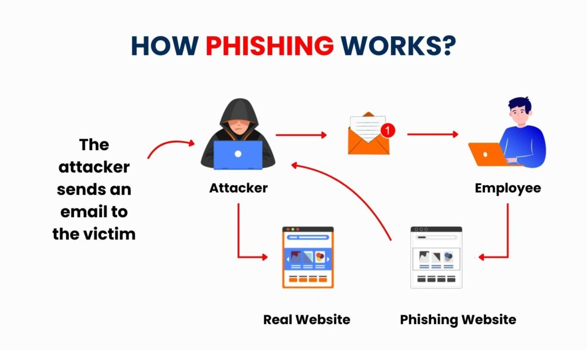
What is Phishing?
Phishing is a cyberattack where criminals impersonate trusted individuals or organization to trick people into:
Revealing passwords
Sharing personal information
Sending money
Installing malware
Common Targets
Email accounts
Banking credentials
Social media accounts
Corporate systems

Slide 4
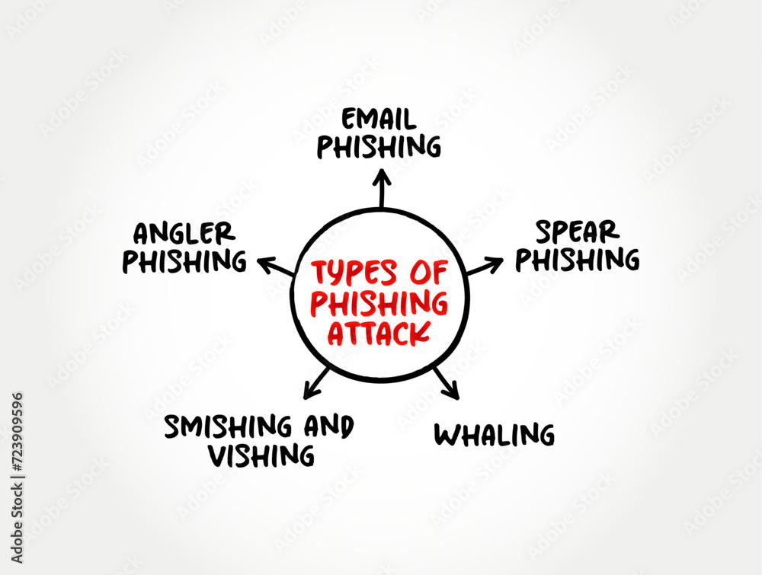

Types of Phishing Attacks
Email Phishing :- Fake emails pretending to be from legitimate organization.
Spear Phishing :- Targeted attacks aimed at specific individuals.
Whaling :- Attacks targeting executives or senior management.
Smishing :- Phishing through SMS/text messages.
Vishing :- Phishing through phone calls.
Angler Phishing :- It is a new scam technique where cyber actors masquerade as customer support staff using social media platforms and accounts.

Slide 5
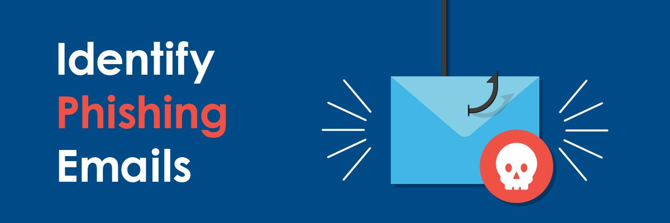
How to Recognize Phishing Emails?
Suspicious sender addresses
Urgent or threatening language
Spelling and grammar mistakes
Unexpected attachments
Request for passwords or sensitive information
Links that don’t match the displayed website

Slide 6
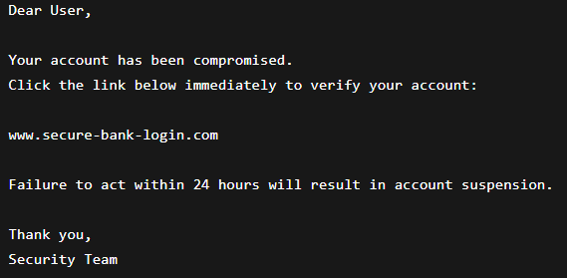
Example of a Phishing Email
Red flags
Creates panic
Generic greeting
Suspicious URL
Requests immediate action

Slide 7

How to Spot Fake Websites
Check :
🔒 HTTPS and security certificate
🌐 Correct domain name
⚠️ Poor design or formatting
⚠️ Unusual pop-ups
⚠️ Requests for unnecessary personal information
Example:
Legitimate :
Fake :

Slide 8
Social Engineering Tactics
Attackers often exploit human psychology through:
Fear
Urgency
Curiosity
Trust
Authority
Examples :
“ Your account is locked .”
“ You’ve won a prize.”
“CEO requests immediate payment.”
“ Security verification required.”

Slide 9
Real- World Example
Example 1 :-
Fake delivery notification payment for package release.
Example 2 :-
Emails pretending to be form IT support asking users to reset passwords.
Example 3 :-
Fake banking alerts requesting login verification.

Slide 10
Best Practices
Do :
✅ Verify sender identity
✅ Hover over links before clicking
✅ Use multi-factor authentication (MFA)
✅ Keep software updated
✅ Report suspicious messages
Don’t :
❌ Share passwords via email
❌ Open unexpected attachments
❌ Click suspicious links
❌ Trust urgent requests without verification

Slide 11
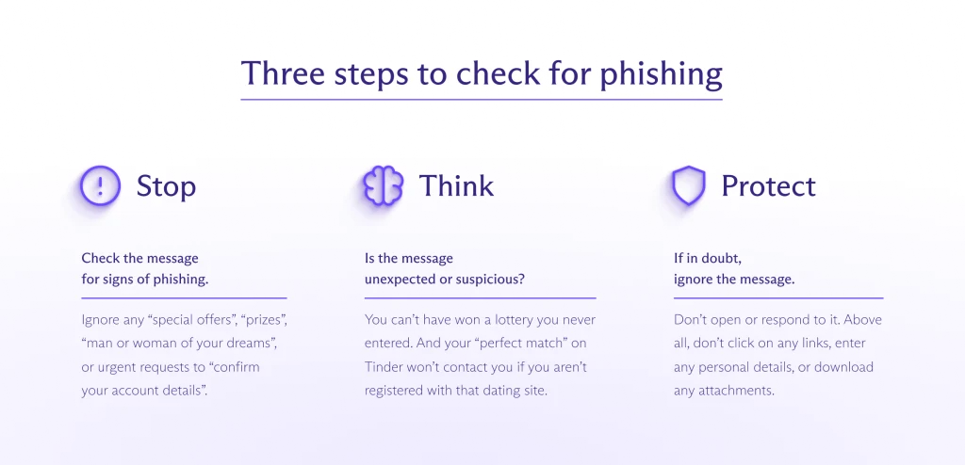
What to do If you Suspect Phishing?
Do not click links.
Do not open attachments.
Report the message to IT/security.
Delete the message.
Change passwords if credentials were entered.
Enable MFA if not already enabled.

Slide 12
Interactive Quiz
Question 1
Which of the following is a common sign of phishing?
A. Personalized communication B. Requests for sensitive information C. Official company logo D. Proper grammar
Answer: B
Question 2
What should you do before clicking a link?
A. Open it immediately B. Forward it to friends C. Hover over it and verify the URL D. Disable antivirus
Answer: C

Slide 13
Question 3
Which tactic is commonly used in phishing?
A. Patience B. Transparency C. Urgency and fear D. Technical support
Answer: C
Question 4
What is MFA?
A. Multi-Factor Authentication B. Mobile File Access C. Managed Firewall Access D. Mail Filtering Application
Answer: A

Slide 14
Key Takeaways :
Think before you click.
Verify requests for sensitive information.
Be cautious of urgency and pressure.
Use strong passwords and MFA.
Report suspicious communications immediately.
Remember: If something feels suspicious, verify it through a trusted channel before taking action.

